Slide 1
CE 574: Prescreening
Sava River – Jesenice Gauge
Madi Brake

Slide 2
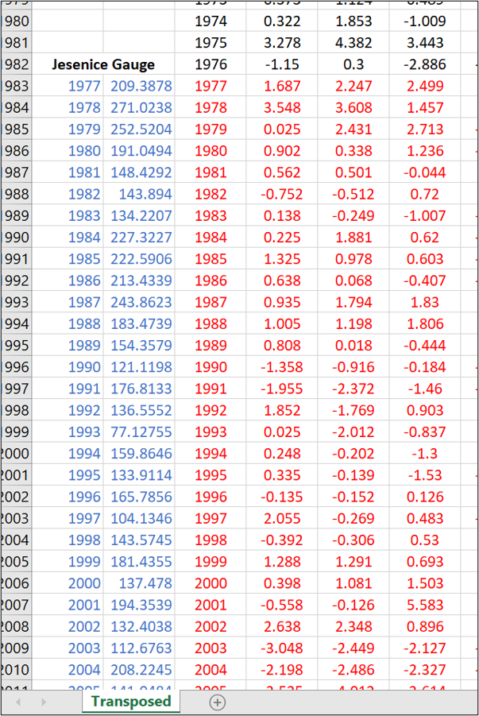
Prescreening Walkthrough
The data from the Jesenice Gauge streamflow data, 1980-2012, and the PDSI cell data for the same years were used for the prescreening of the Sava River Reconstruction Deliverable.
Blue data = AMJJAS streamflow data from Jesenice Gauge (1977-2012)
Red data = PDSI cells corresponding to 1977-2012.
Only years 1980-2012 were used for this project.

Slide 3
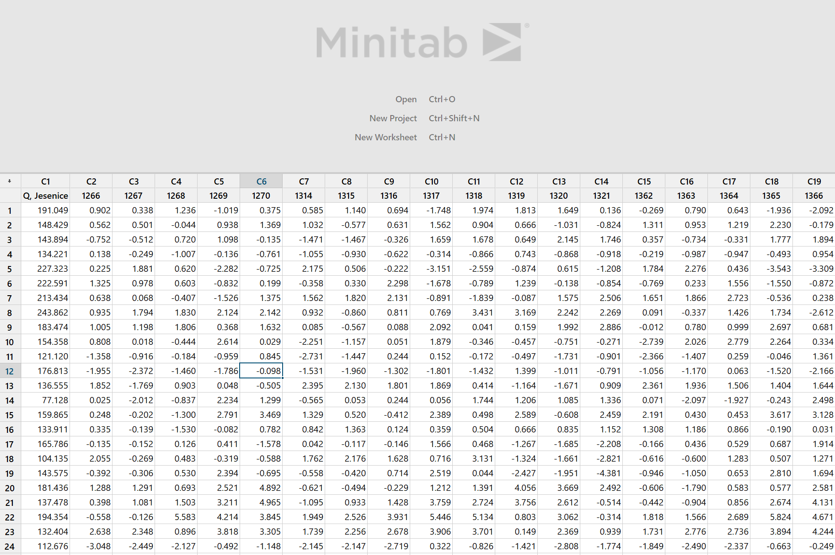
Prescreening Walkthrough
2) The correlation of PDSI and AMJJAS streamflow data from the Jesenice Gauge (1980-2012) was done using Minitab Statistical Software.
The Jesenice Gauge streamflow data (column 1 "Q, Jesenice") and PDSI cell data (columns 2 through 250, numbers above them represent the cell #) were inserted into the Minitab software, as seen in the figure to the right.

Slide 4
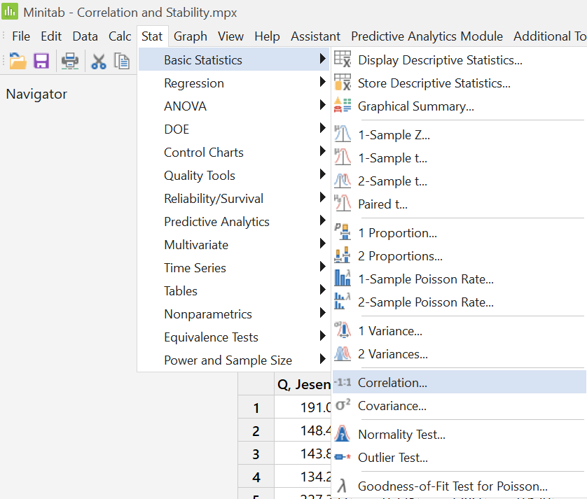
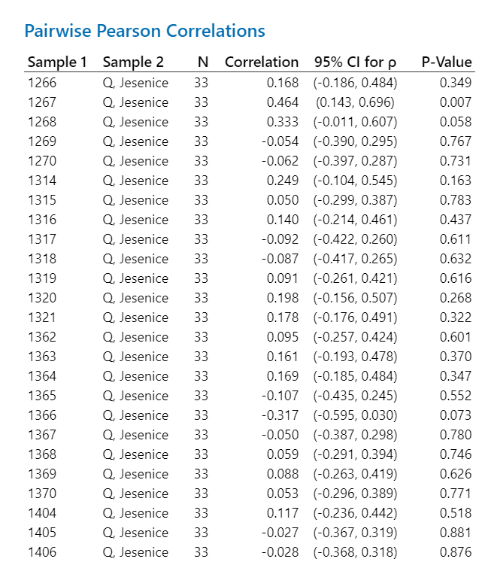
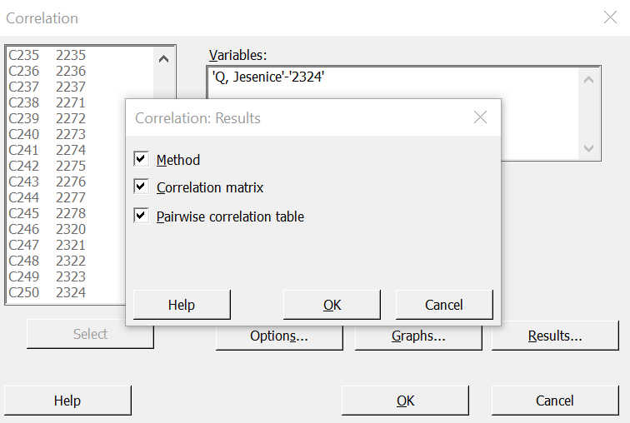
Prescreening Walkthrough
3) Using basic statistics – correlation function in Minitab, and selecting all PDSI and streamflow data, a pairwise correlation table was generated for the data.

Slide 5
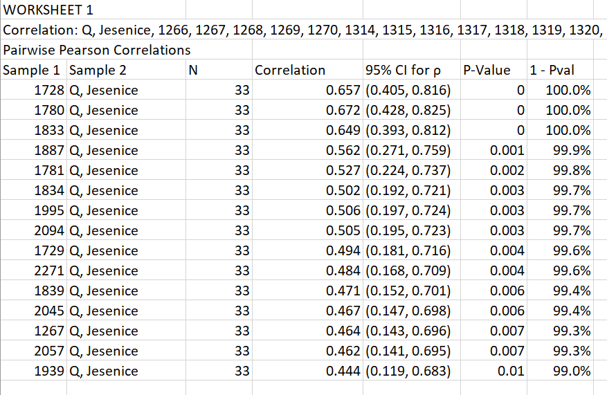
Prescreening Walkthrough
5) The data was pasted into an excel sheet, and the unnecessary data (PSDI to PDSI correlation) was deleted.
A column was created for 1 minus P-Value (represented as a percentage) for the correlations and sorted from largest to smallest.
Anything under 99% for 1 minus P-value was deleted. The correlations were checked to be positive.

Slide 6
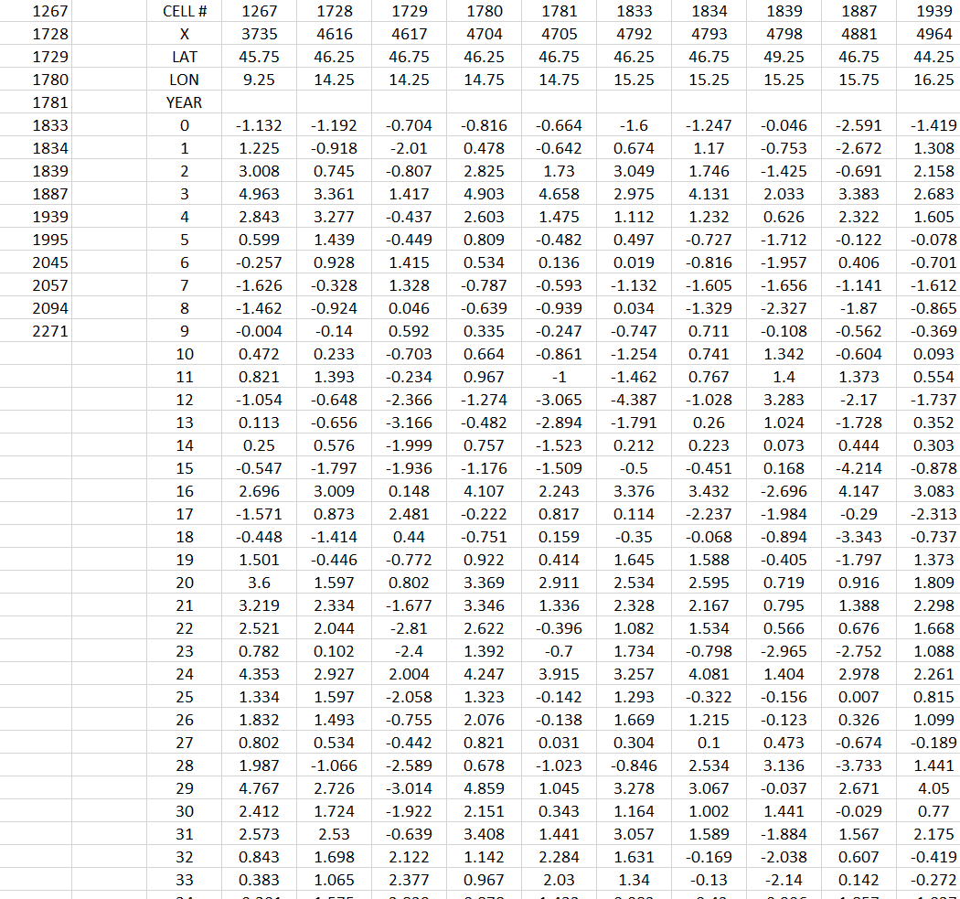
Prescreening Walkthrough
6) The PDSI cell labels with the positive correlation and >99% correlation were retained on a new sheet called "Jesenice and PDSI Correlation" as seen in the figure to the right.
These cells passed the first test of prescreening.

Slide 7
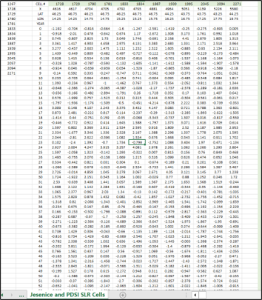
Prescreening Walkthrough
7) A stability testing sheet was created titled "Jesenice and PSDI Stability."
The years 1980-1990 were chosen to correlate, locking the streamflow data in place and using a 11-year moving window for the retained PDSI cells.
Then, the minimum value for each PDSI cell number moving window was found, and if it was negative, returned a 0. A positive minumum value returned a 1.
The PDSI cells returning a 1 were highlighted in green and retained on another sheet for SLR to be performed in the next deliverable.

